Slide 1
GORIC & GORICA
Evaluation of theory-based (inequaility-restricted) hypotheses
using (AIC-like) information theoretical model selection,
that is, using (AIC-like) information criteria.

Slide 2

Overview GORIC & GORICA in R (restriktor) and JASP
 | GORIC R | GORIC JASP | GORICA R | GORICA JASP
ANOVA
RM-ANOVA
Regression |  | Not yet
SEM |  |  |  | Future?
Other model |  |  |  | Future?

Slide 3
GORIC & GORICA in R (restriktor)
Link to R-tutorials for GORIC and GORICA:
https://github.com/rebeccakuiper/Tutorials
Links to R scripts for GORICA on several type of statistical models:
https://github.com/rebeccakuiper/GORICA_in_SEM
https://github.com/rebeccakuiper/GORICA_on_MetaAn
https://github.com/rebeccakuiper/GORICA_on_CTmeta
https://github.com/rebeccakuiper/GORICA_in_CLPM

Slide 4
GORIC & GORICA in JASP
In the upcoming slides, there are prints screens which show how to apply GORIC & GORICA to evaluate informative / theory-based hypotheses in various types of statistical models in JASP.
Currently:
- GORIC for a one-way ANOVA model
Future:
- GORIC for ANOVA model with more than factor (with and without interactions)
Is possible now, but uses effect coding (and sometimes confusing labels)
- GORICA for Repeated-measures ANOVA
- GORIC for regression models

Slide 5
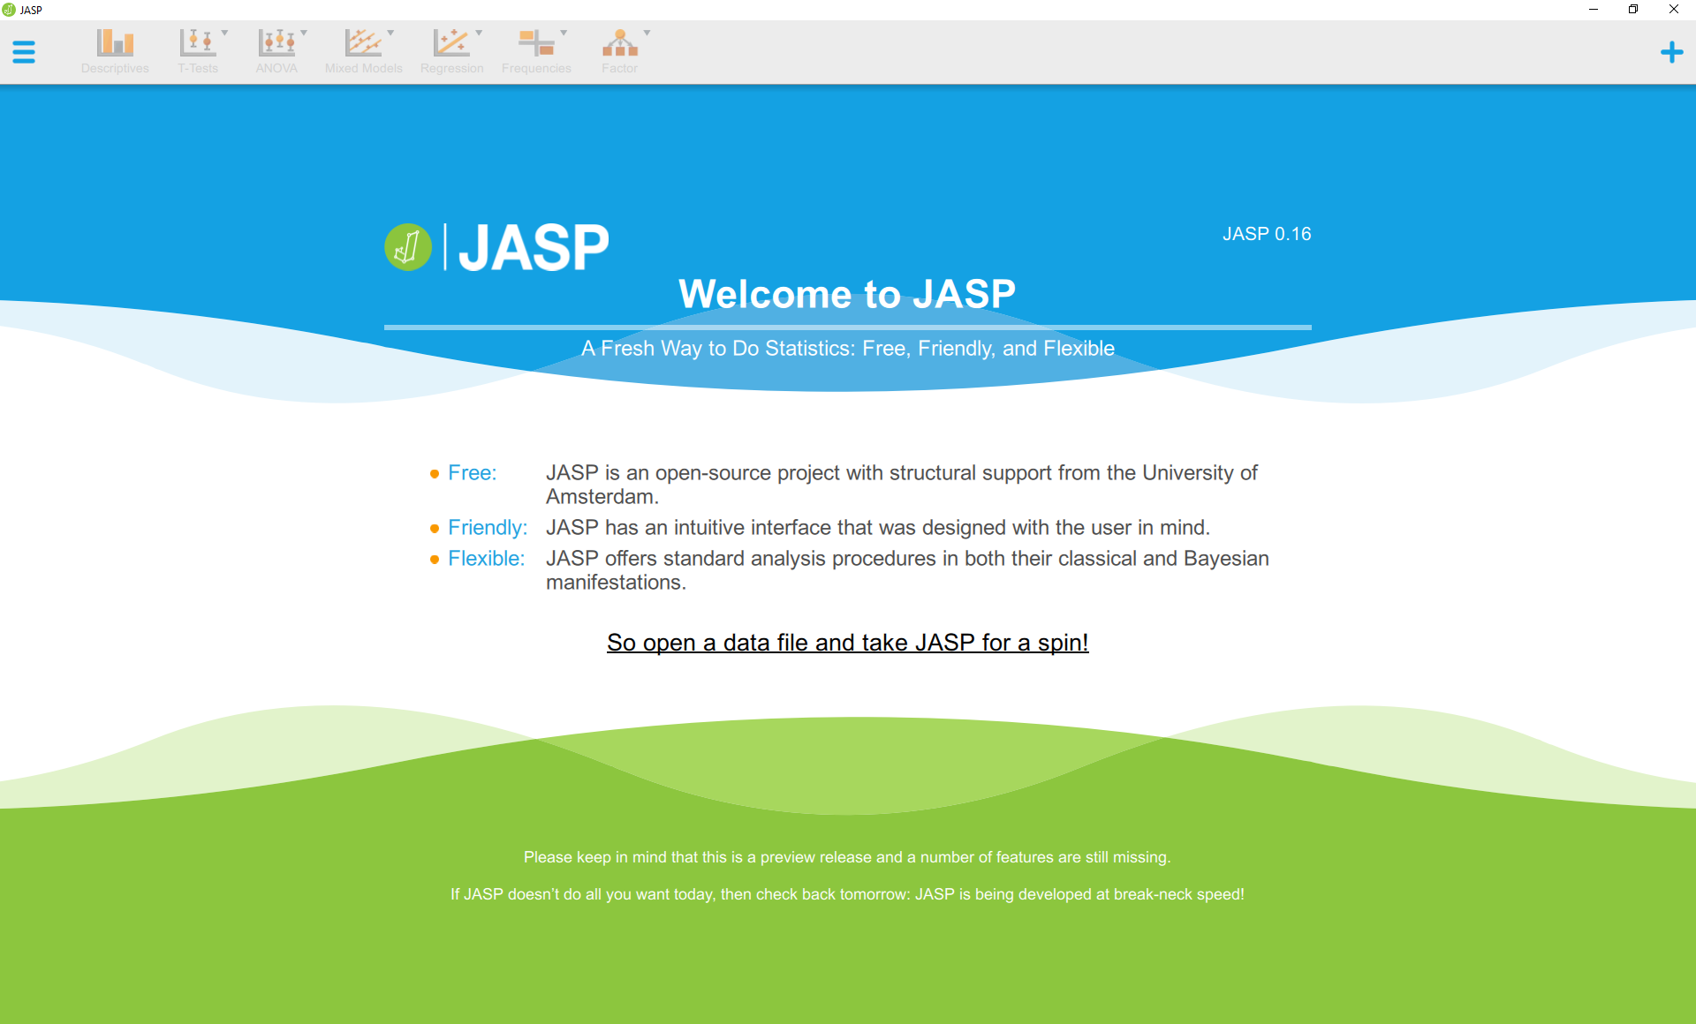

Slide 6
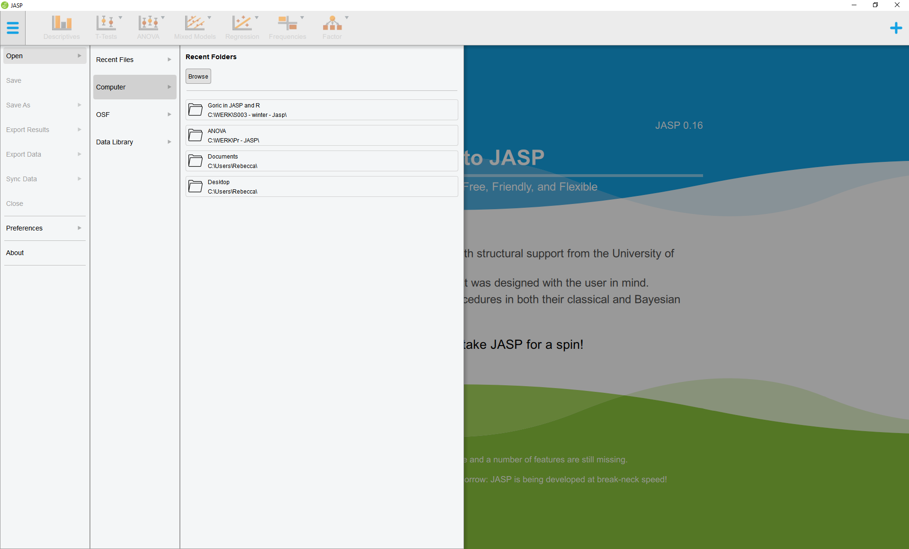

Slide 7
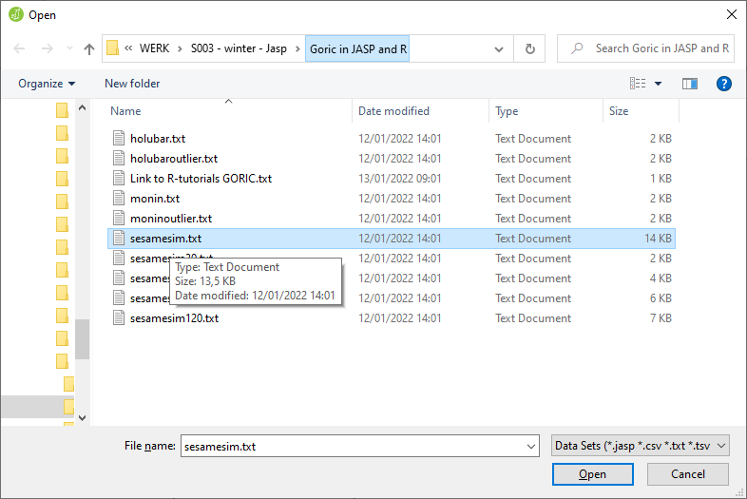

Slide 8
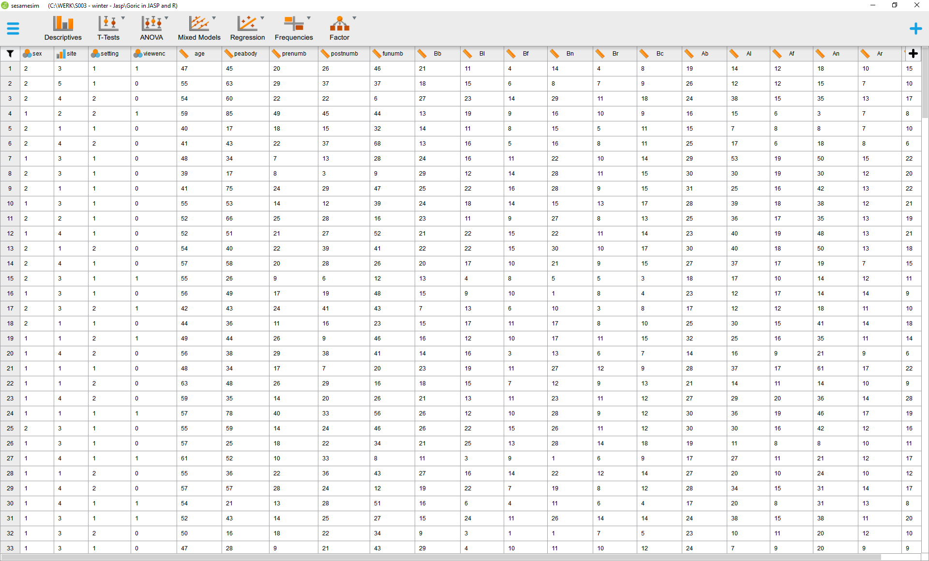

Slide 9
GORIC
ANOVA

Slide 10
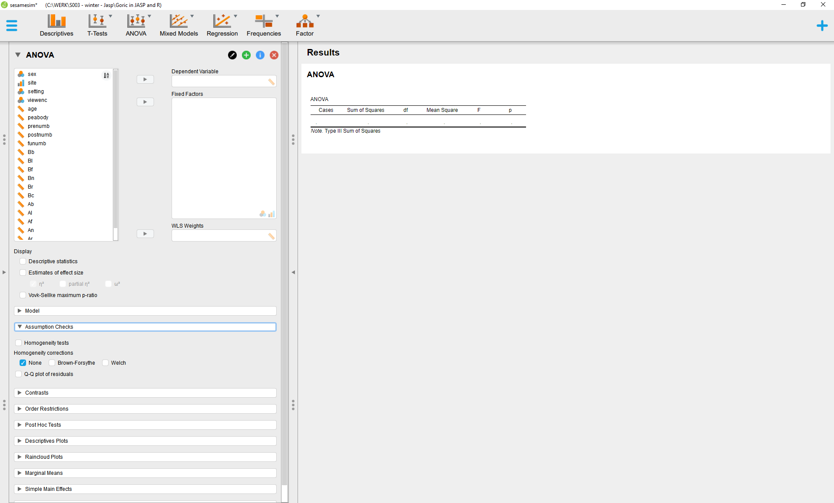
Note: The assumption checks are skipped, but can easily be done in JASP

Slide 11
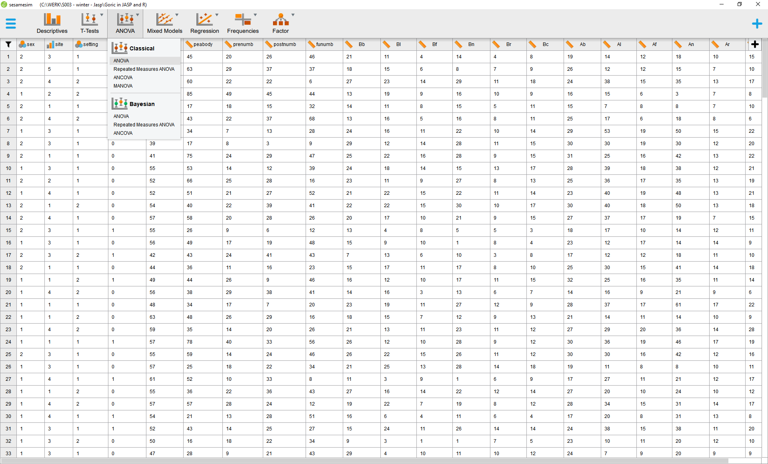

Slide 12
GORIC
ANOVA Example 1: 1 factor

Slide 13
Is there a difference in "knowledge of numbers after watching Sesame Street for a year“ (postnumb)
between the five sites from which the child originates (site)
site:
1 = disadvantaged inner city,
2 = advantaged suburban ,
3 = advantaged rural,
4 = disadvantaged rural,
5 = disadvantaged Spanish speaking.
For illustrational purposes, H₀: µ₁ = µ₂ = µ₃ = µ₄ = µ₅ is included (Model 1). Btw In practice, only include such a null when you are truly interested in it.
Hypothesis of interest: H₁: µ₂ > µ₅ > µ₁ > µ₃ > µ₄ (Model 2).
Because there are two hypotheses that do not cover the whole space, H_{unc}: µ₁, µ₂, µ₃, µ₄, µ₅ is included as failsafe (Unconstrained) – this represents all possible hypotheses including the ones in the set.

Slide 14
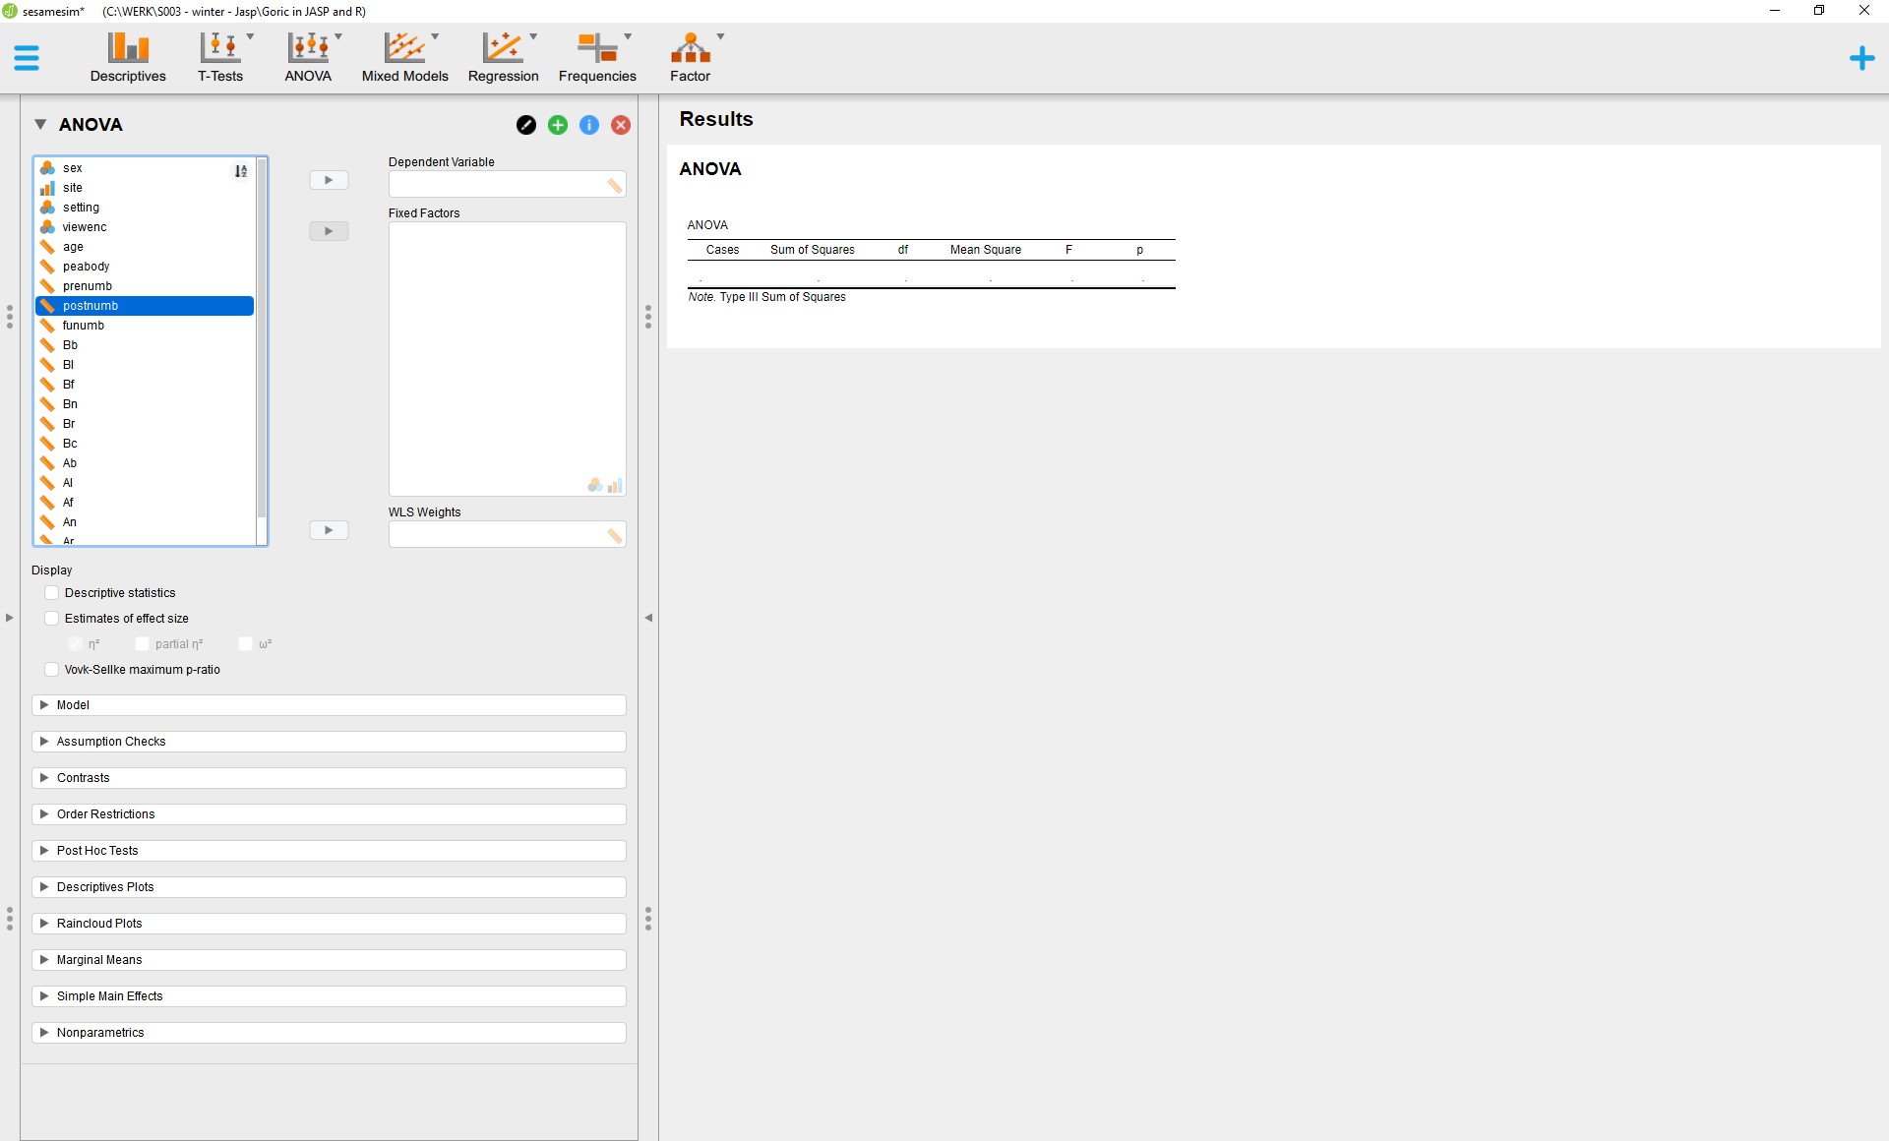

Slide 15
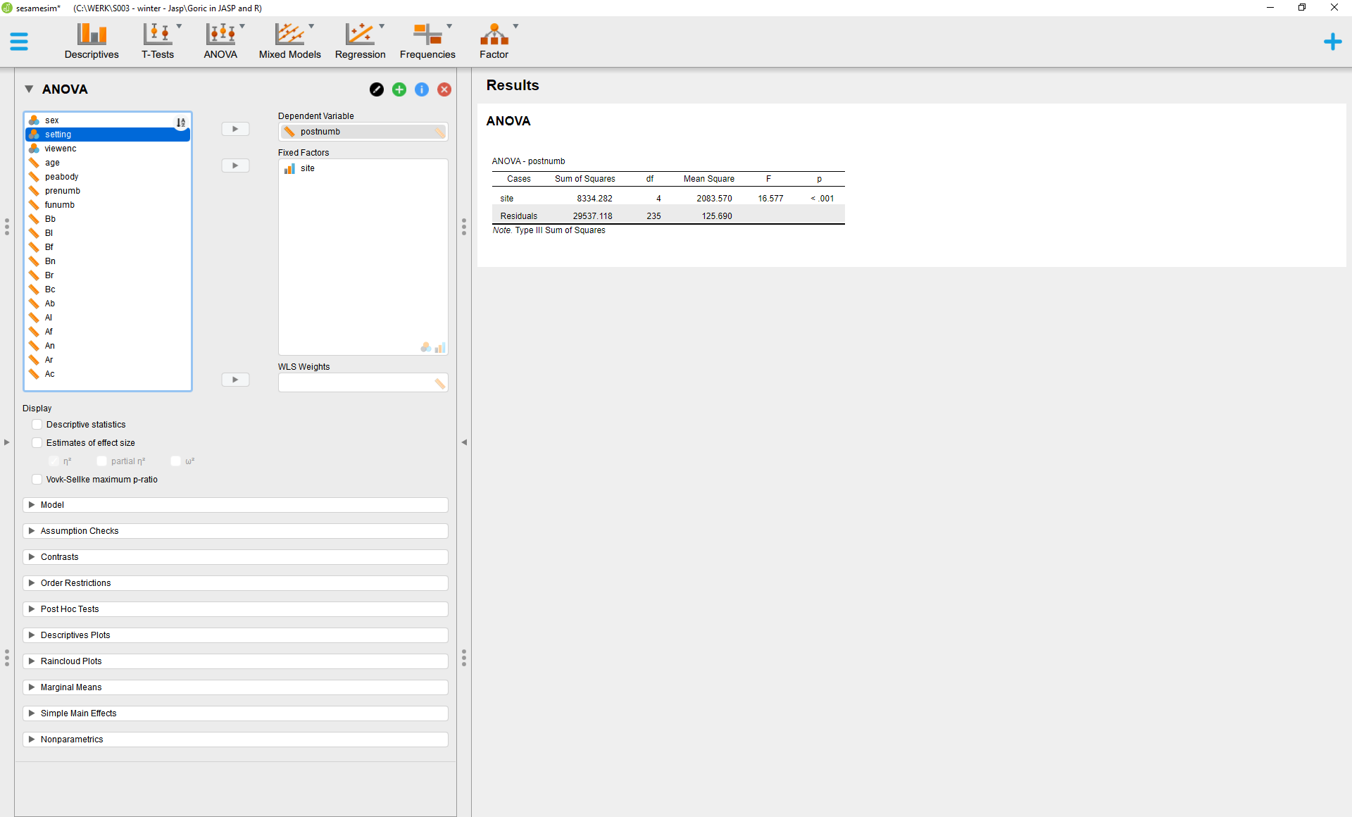
You can also tick the descriptive statistics box,
but make sure that your hypotheses are known before looking at the descriptive statistics.

Slide 16
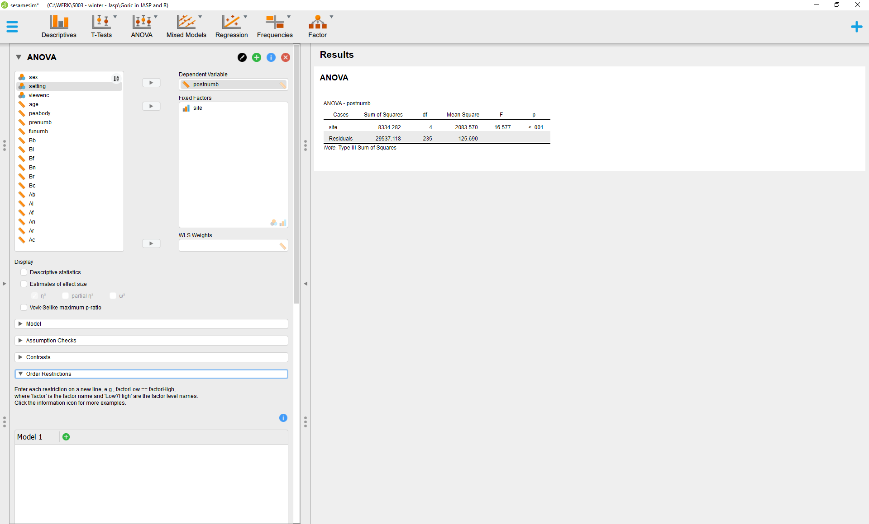

Slide 17
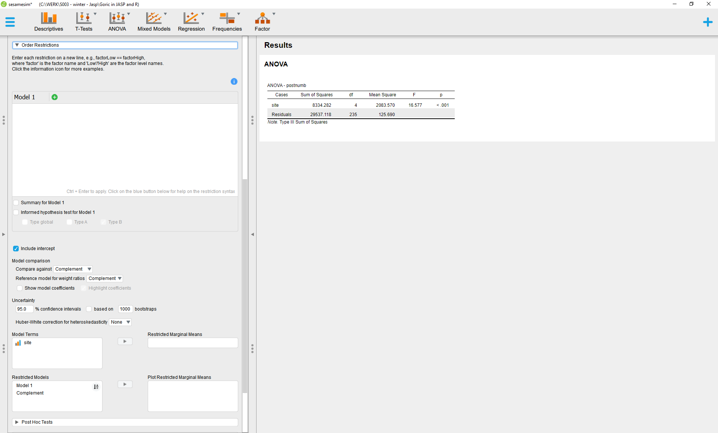

Slide 18
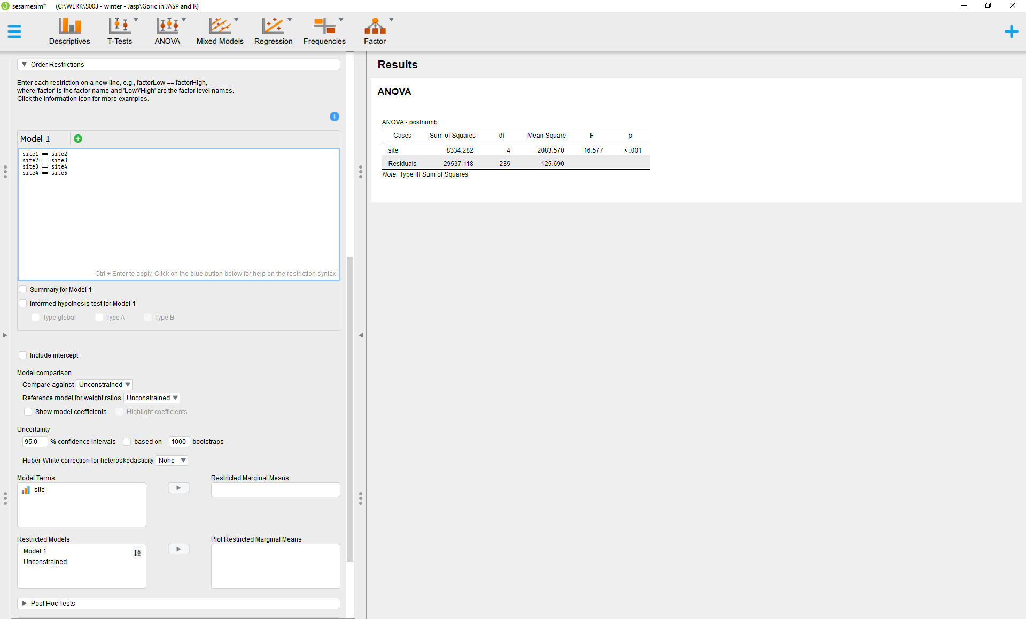
Unclick, when you want to use the notation above!
Elsewise, you have to use .Intercept. as well (see blue icon and 2-way ANOVA example later on).

Slide 19
A hypothesis is specified using population parameters,
but with JASP (or R) one should use the variable name and the level.
One should use here: site1, …, site5.

Slide 20
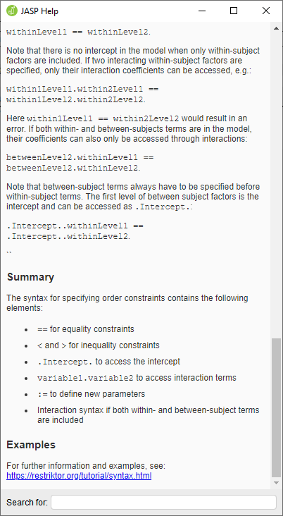

Slide 21
In case of equality restrictions,
use “== “instead of “=“.

Slide 22
Press Ctrl+Enter (in a newer version this should be done when all models are entered).

Slide 23
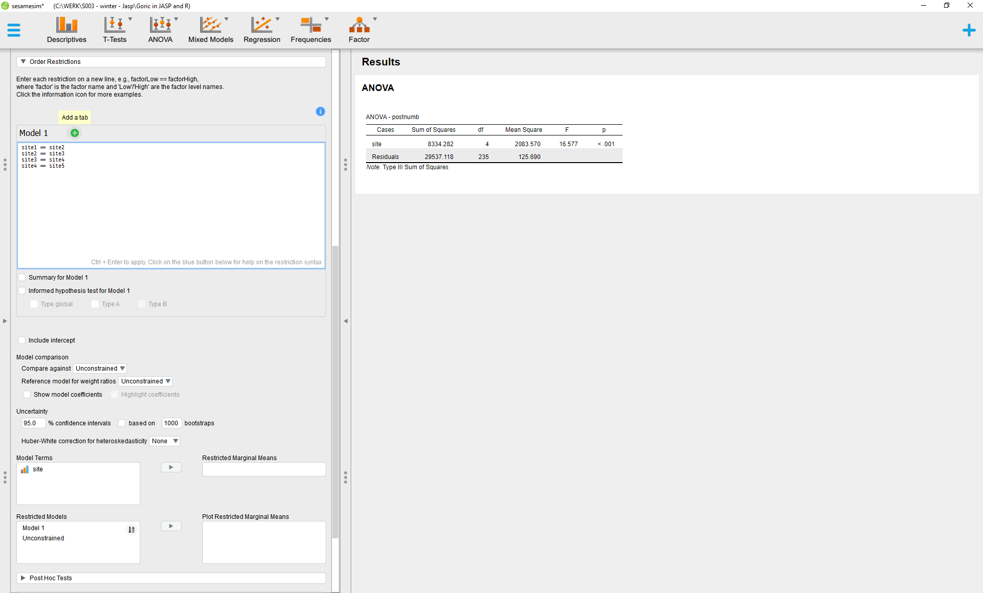

Slide 24
Intermezzo: Hypothesis of interest
H₁: µ₂ > µ₅ > µ₁ > µ₃ > µ₄ (Model 2)
is reflected in JASP by:
site2 > site5
site5 > site1
site1 > site3
site3 > site4
Note: A hypothesis is specified using population parameters,
but with JASP (or R) one should use the variable name and the level.
One should use here: site1, …, site5.

Slide 25
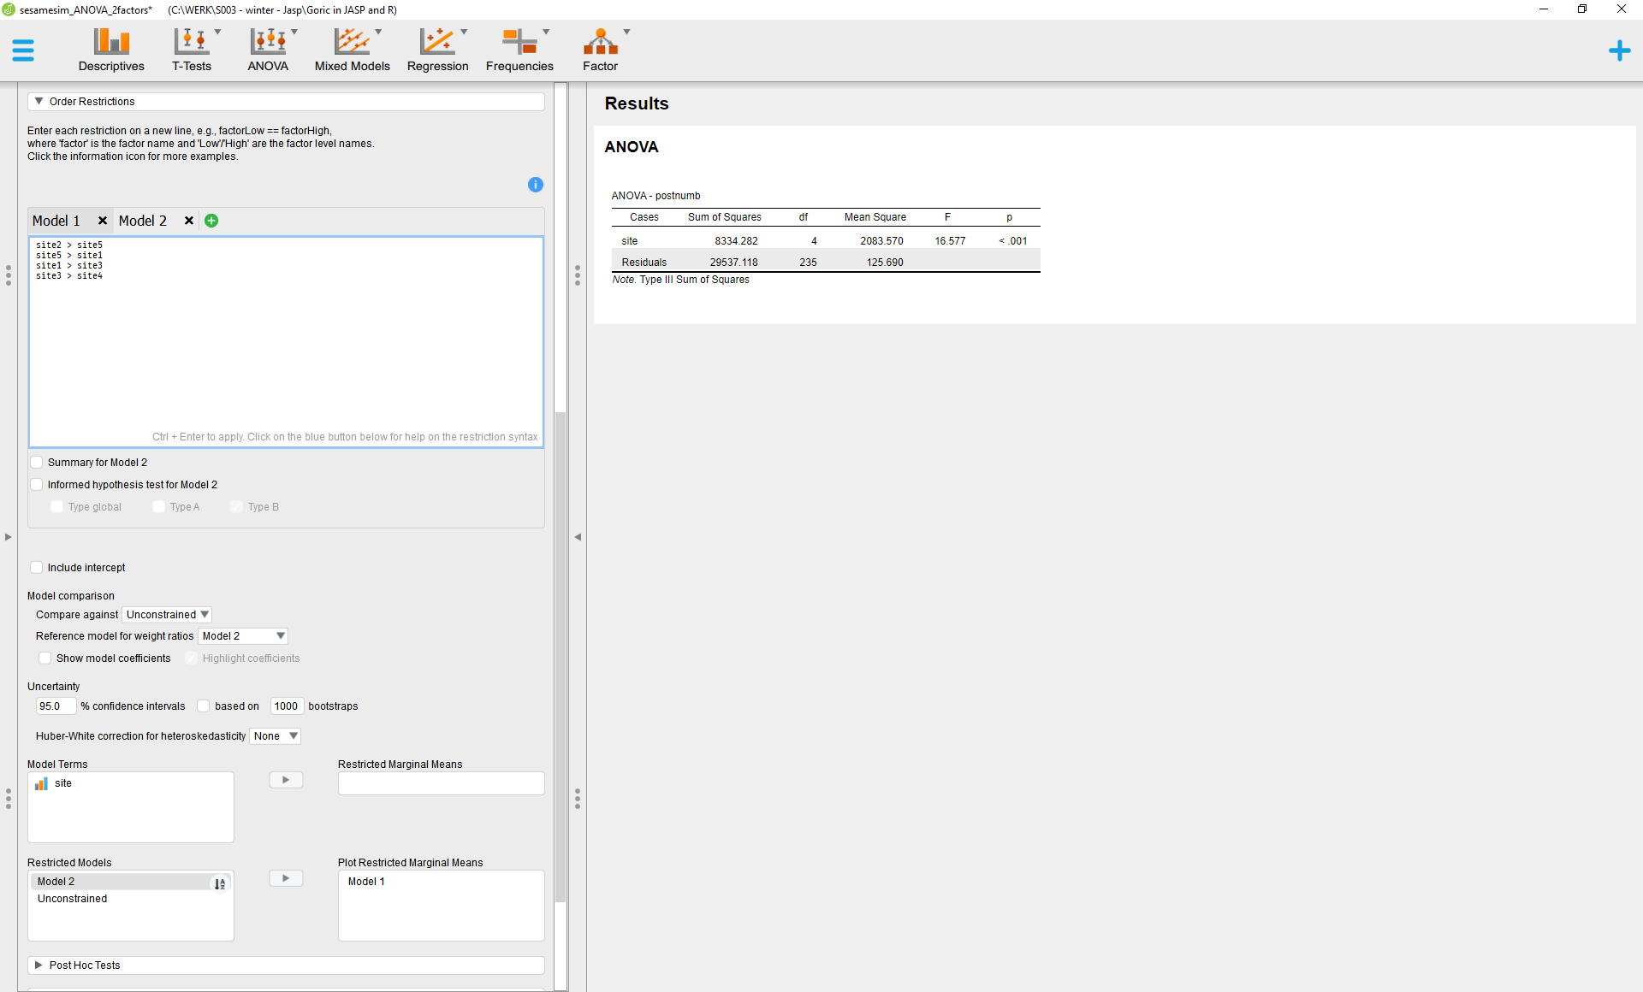

Slide 26
Press Ctrl+Enter (in a newer version this should be done when all models are entered).

Slide 27
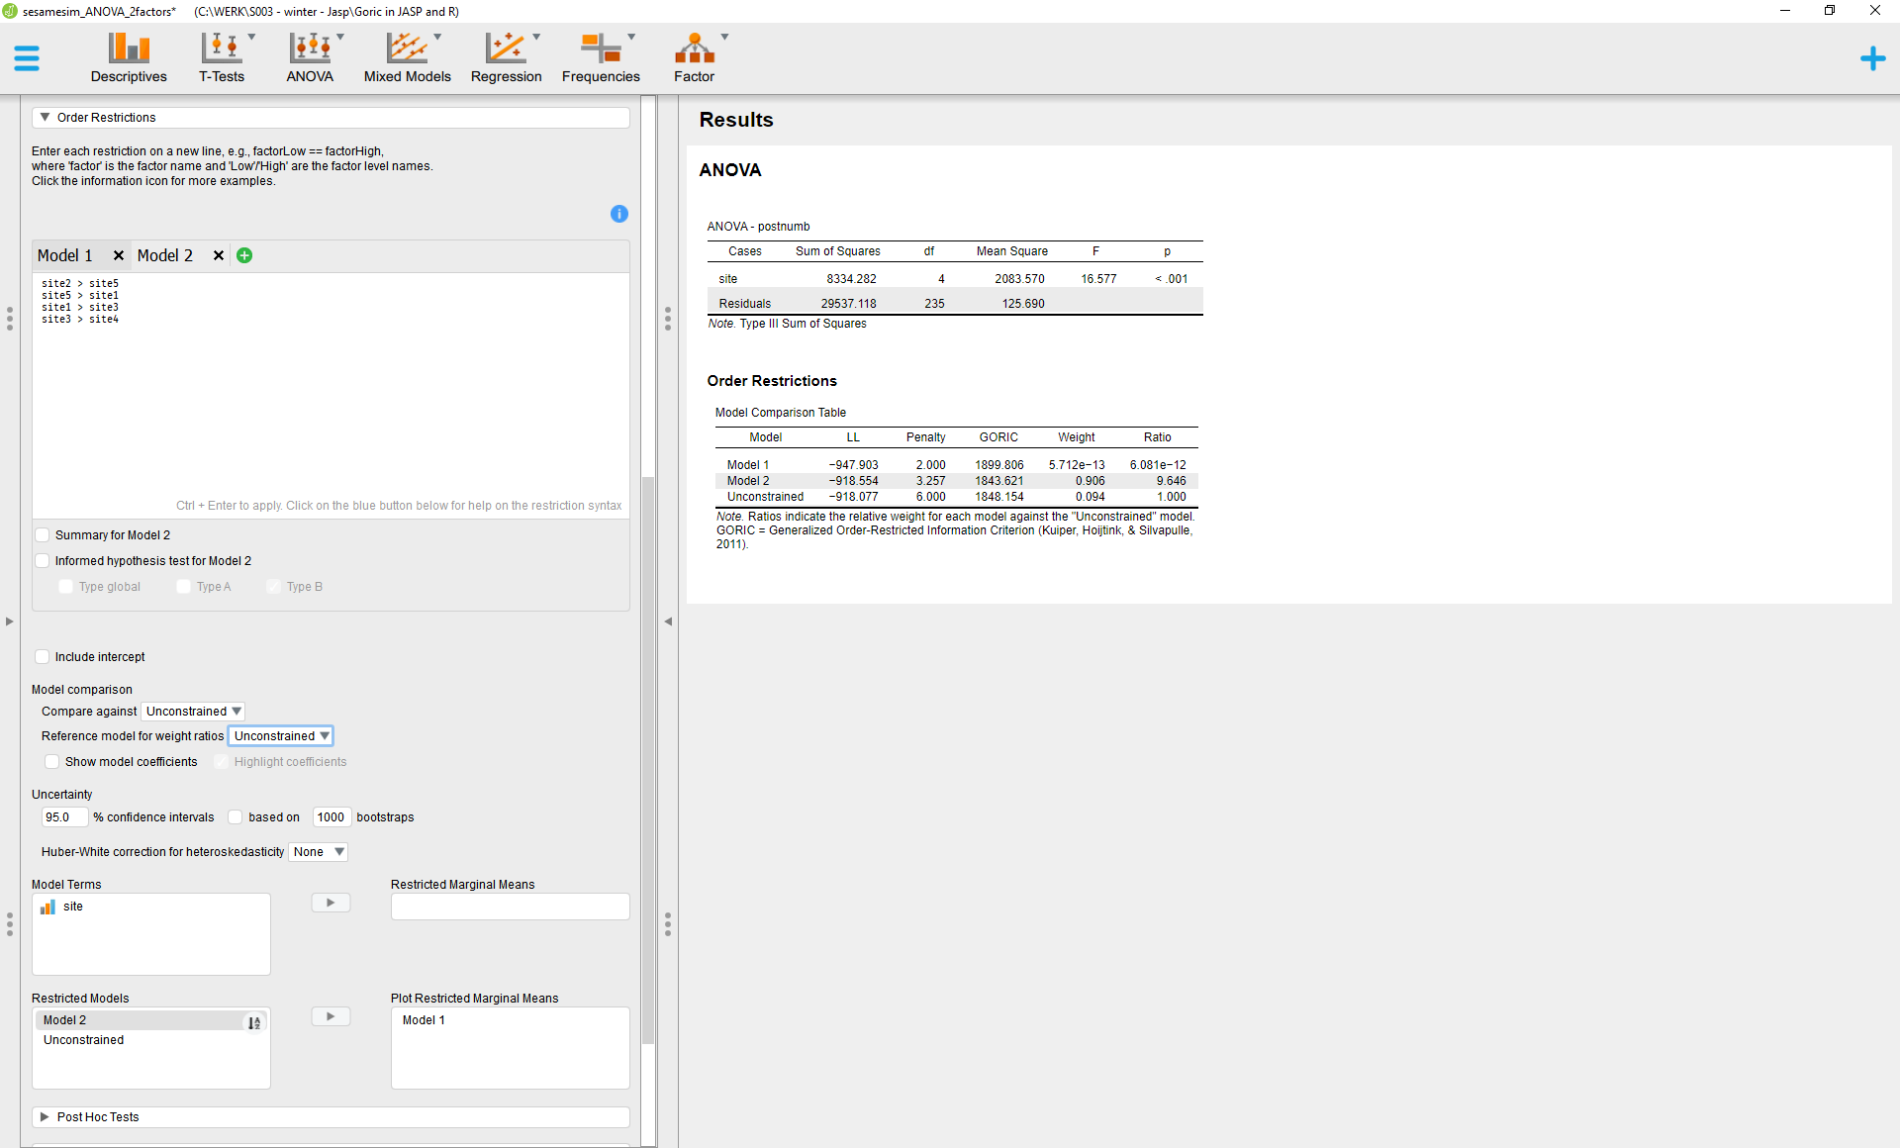

Slide 28
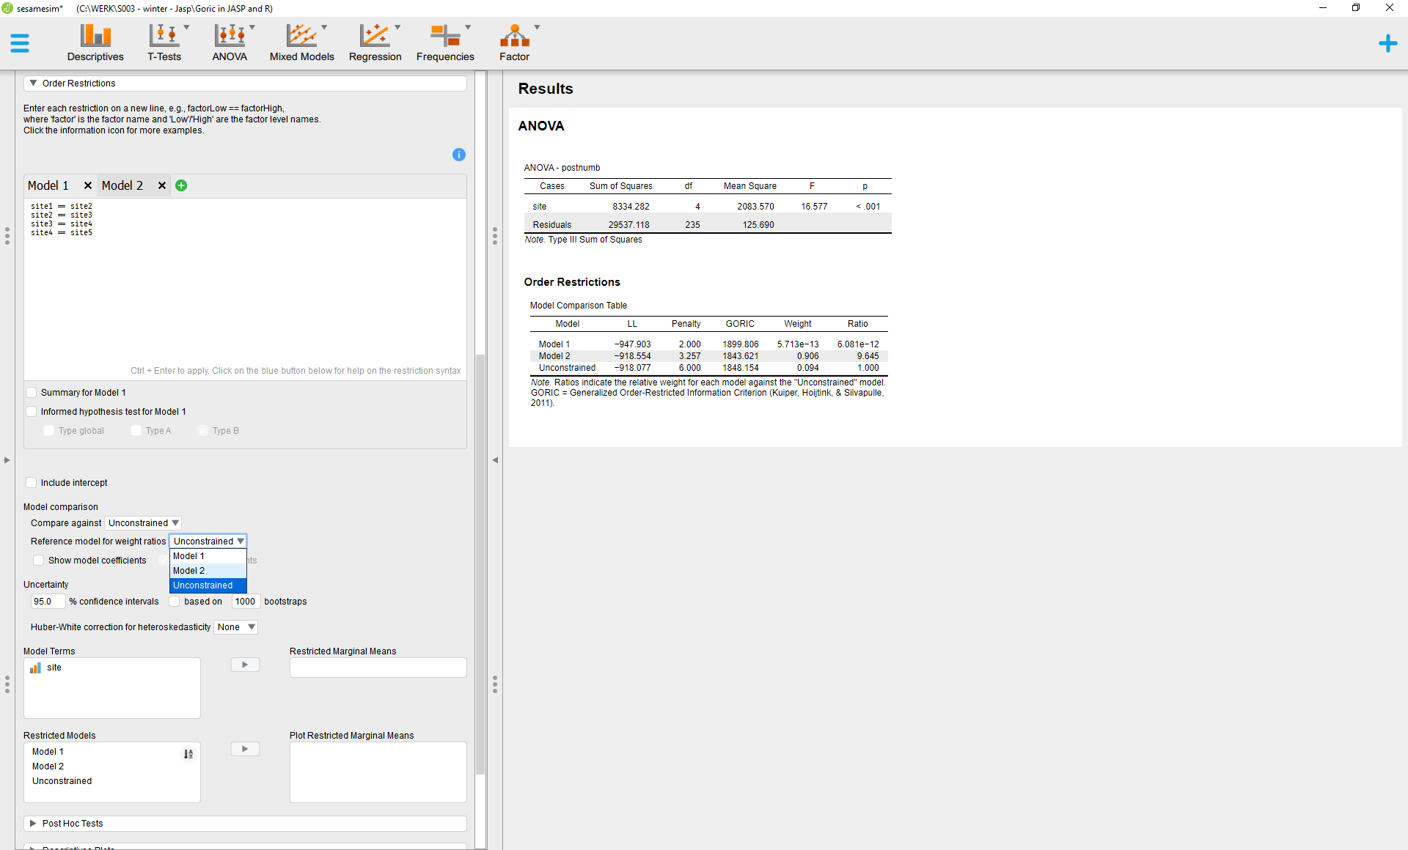

Slide 29
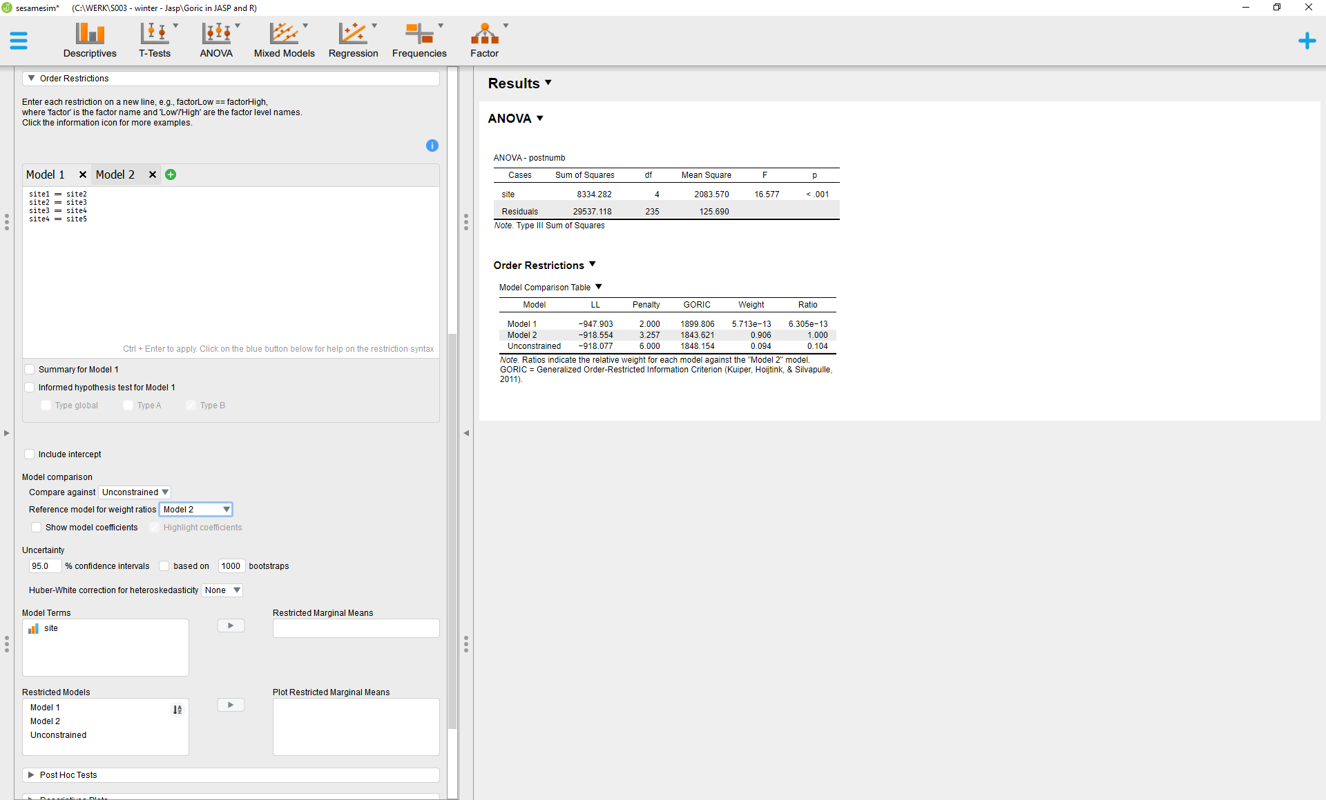

Slide 30
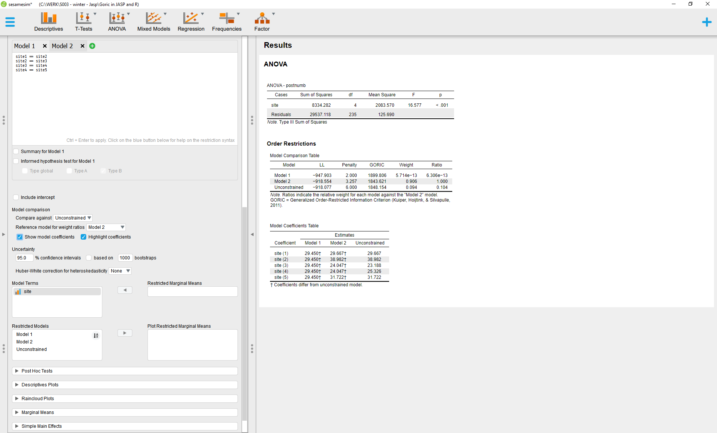

Slide 31
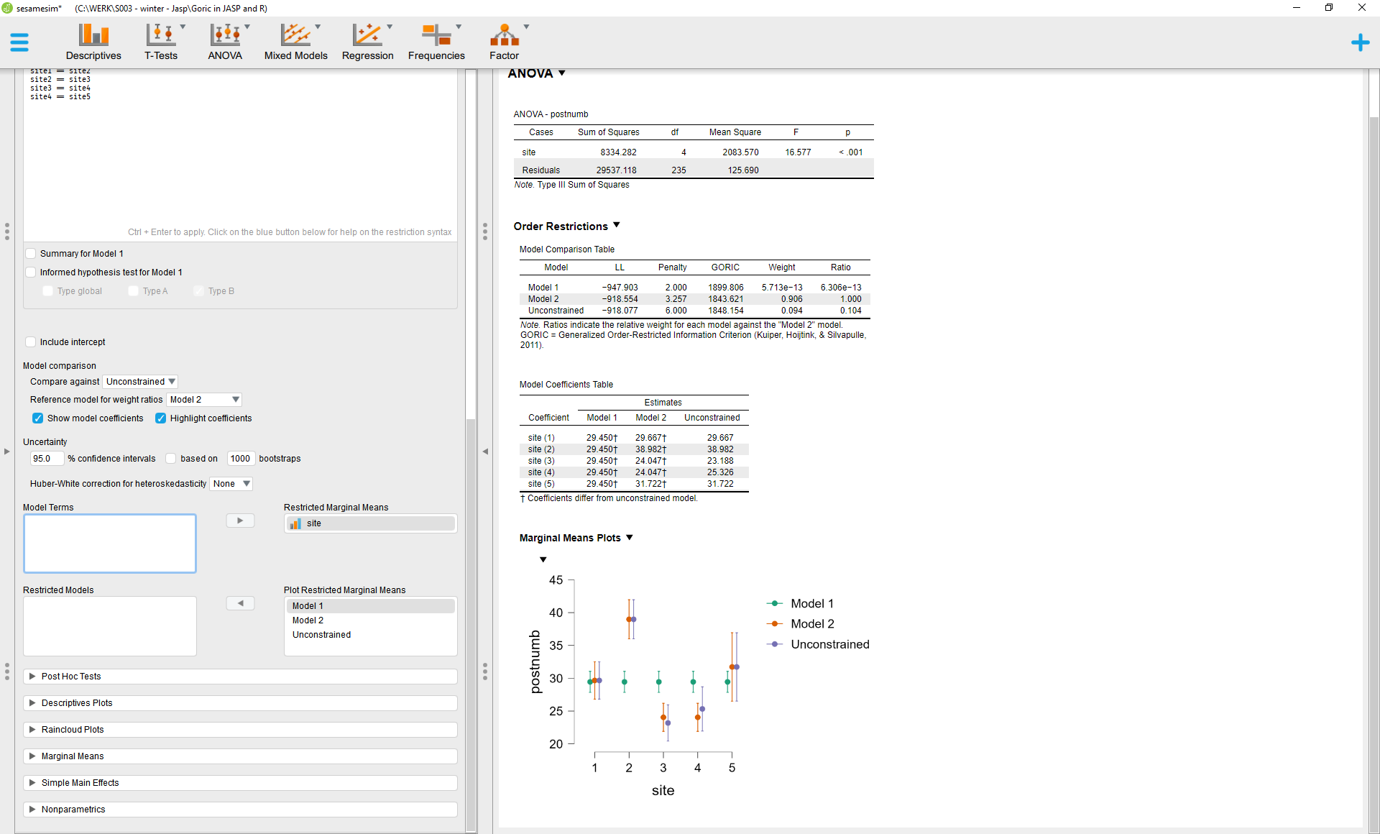

Slide 32

Model 2 is the preferred hypothesis (lowest GORIC and highest GORIG weight).
Model 2 is .906/.094≈9.6 >1 times more likely than the Uncontrained.
Thus, it is not a weak hypothesis.
Therefore, it can be compared to the other hypotheses in the set.
Model 2 is many more times supported than Model 1.
Model 2 is the preferred hypothesis and
its support in comparison with Model 1 is very convincing.

